Slide 1
EPICv2 Docker: “Fingerprinting Enabled!”
Bret D. Barnes
20/07/2023

Slide 2
Outline
July 20th, 2023
SNV Venn-Diagrams
Allele Frequency Densities
Fingerprints
Fingerprint Clustering
Wanding’s Fingerprints
Next Steps: Future Fingerprints
Summary and Conclusion

Slide 3
SNV Venn-Diagrams New SNVs

Slide 4
SNV Venn-Diagrams
New SNVs
Basic Counts…

Slide 5
SNV Venn-Diagrams
New SNVs
Trifecta (Inferred) SNV Probes Direct Detection SNV Probes

Slide 6
Allele Frequency Densities Direct SNVs Matter Most!

Slide 7
Allele Frequency Densities
Direct SNVs Matter Most!
Direct SNPs were designed specifically to have high MAF!
High MAF = Stronger Fingerprinting Discrimination!
This means that a lack of Trifecta (Inferred) SNVs does not have a strong effect.
RAF = Reference Allele Frequency
MAF = Minor Allele Frequency

Slide 8
Fingerprints Convenient Fingerprinting Visualize

Slide 9
Fingerprints
Convenient Fingerprinting Visualize
NOTES: Color code values…
Key:
0 = 0/0
1 = 0/1
2 = 1/0
3 = 1/1
5 = NA

Slide 10
Fingerprint Clustering Fingerprints vs. Betas

Slide 11
Fingerprint Clustering
Fingerprinted Heatmap
Perfect Clustering!
Split cluster for the high/low quality NA12878 samples!

Slide 12
Fingerprint Clustering
Beta(CpG) Heatmap
Same cluster!
Same cluster for the high/low quality NA12878 samples!

Slide 13
Wanding’s Fingerprints Fingerprints vs. Betas

Slide 14
Wanding’s Fingerprints
Fingerprinted Heatmap
NOTES: Classes are at a very high level.
Most have different parameterizations
TBD: insert GEO/Paper Links

Slide 15
Wanding’s Fingerprints
Beta(CpG) Heatmap
NOTES: Still very similar clustering!
TBD: insert GEO/Paper Links

Slide 16
Next Steps: Future Fingerprints Rare SNV Discovery

Slide 17
Next Steps: Future Fingerprints
Rare SNV Discovery
By extending the VCF generation to all Infinium I probes you can “discover” evidence for really rare SNV’s in large datasets like the VA’s MVP EPIC Project!
TBD: Add more details…

Slide 18
Summary and Conclusion EPICv2 Docker can Perform Fingerprinting

Slide 19
Summary and Conclusion
EPICv2 Docker can Perform Fingerprinting
Overlap meets requirements
All the heavy lifting SNVs are present
There are more SNVs that can be applied
Fingerprinting has been demonstrated on provided datasets
Fingerprinting can be extended to discover on EPICv1 and EPICv2 datasets
EPICv2 Docker can Perform Fingerprinting!

Slide 20
Data Links
Supplementary
Evaluating The Infinium Human MethylationEPIC v2 BeadChip
Kaur D, Lee S, Goldberg D, et al. Evaluating The Infinium Human MethylationEPIC v2 BeadChip. Research Square; 2023. DOI: 10.21203/rs.3.rs-2781268/v1.
GEO: https://www.ncbi.nlm.nih.gov/geo/query/acc.cgi?acc=GSE228820
Examining the immunoepigenetic-gut microbiome axis in the context of self-esteem among Native Hawaiians and other Pacific Islanders
Becerra CY, Wells RK, Kunihiro BP, Lee RH, Umeda L, Allan NP, Rubas NC, McCracken TA, Nunokawa CKL, Lee MH, Pidlaoan FGS, Phankitnirondorn K, Dye CK, Yamamoto BY, Peres R, Juarez R, Maunakea AK. Examining the immunoepigenetic-gut microbiome axis in the context of self-esteem among Native Hawaiians and other Pacific Islanders. Front Genet. 2023 Apr 19;14:1125217. doi: 10.3389/fgene.2023.1125217. PMID: 37152987; PMCID: PMC10154580.
https://www.ncbi.nlm.nih.gov/geo/query/acc.cgi?acc=GSE222131

Slide 21
Questions???

Slide 23
Technical Appendix of Docker Changes

Slide 24
Outline
July 19th, 2023
Historic Discovery/Development
Previous insight
Customer Rational
VA MVP Fingerprinting requirements
Current Implementation
Sesame Circa 2019
Current Implementation Caveats
Trials and tribulations of three-year-old code [yes; double entendre ]
Future Development
Genotype manifest integration
Methylation caveats

Slide 25
Historic Discovery/Development Previous insight

Slide 26
Historic Discovery/Development
Previous insight
Original Paper:
Wanding Zhou and others, Comprehensive characterization, annotation and innovative use of Infinium DNA methylation BeadChip probes, Nucleic Acids Research, Volume 45, Issue 4, 28 February 2017, Page e22, https://doi.org/10.1093/nar/gkw967
Two Types of “SNP” Probes
Explicit SNPs = Direct Detection
Recovered SNPs = Inferred Detection (Trifecta Probes)

Slide 27
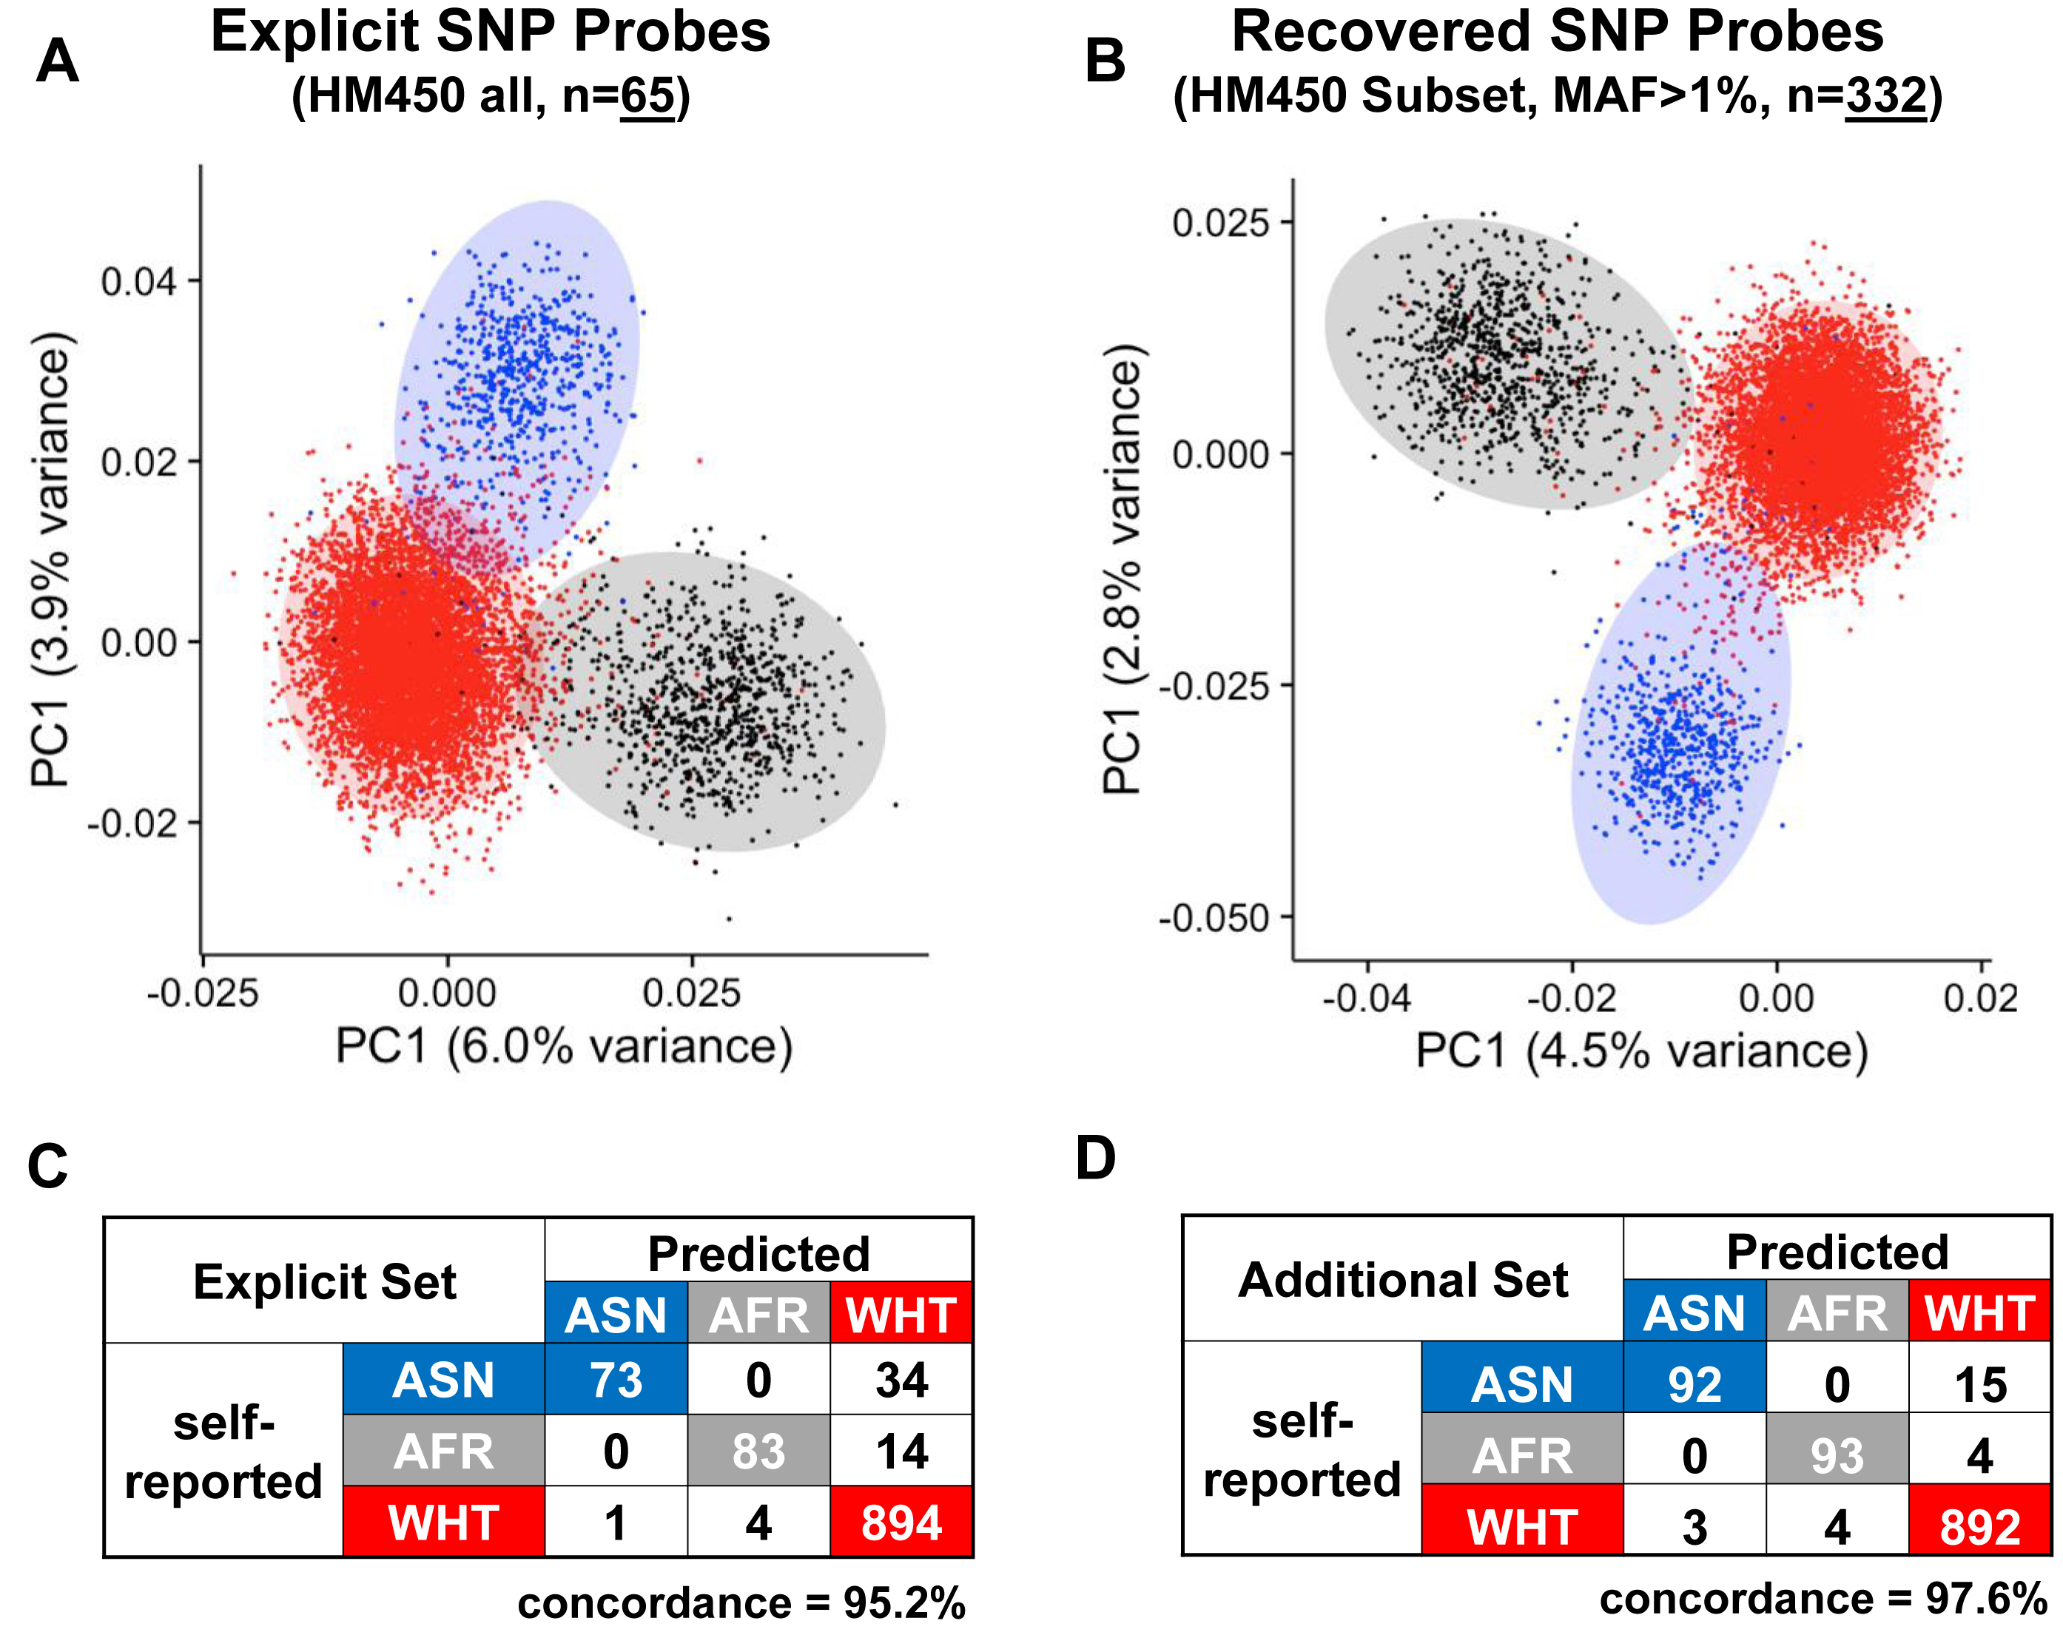

Historic Discovery/Development
Previous insight
Figure 2. (A) Distribution of 8620 TCGA samples on the first and the second principal components identified from beta values measured by explicit SNP probes (rs probes designated by the manufacturer). Samples are colored by self-reported ethnicity; (B) Distribution of 8620 TCGA samples on the first and the second principal components identified from allele frequency recovered from CCS SNP probes; (C) Concordance between self-reported ethnicity and predicted ethnicity using explicit SNP probes on the test dataset (n = 1103, methods); (D) Concordance between self-reported ethnicity and predicted ethnicity using the recovered CCS SNP probes on the test dataset.
Notes:
Figure 2. (A) Distribution of 8620 TCGA samples on the first and the second principal components identified from beta values measured by explicit SNP probes (rs probes designated by the manufacturer). Samples are colored by self-reported ethnicity; (B) Distribution of 8620 TCGA samples on the first and the second principal components identified from allele frequency recovered from CCS SNP probes; (C) Concordance between self-reported ethnicity and predicted ethnicity using explicit SNP probes on the test dataset (n = 1103, methods); (D) Concordance between self-reported ethnicity and predicted ethnicity using the recovered CCS SNP probes on the test dataset.
Unless provided in the caption above, the following copyright applies to the content of this slide: © The Author(s) 2016. Published by Oxford University Press on behalf of Nucleic Acids Research.This is an Open Access article distributed under the terms of the Creative Commons Attribution License (http://creativecommons.org/licenses/by-nc/4.0/), which permits non-commercial re-use, distribution, and reproduction in any medium, provided the original work is properly cited. For commercial re-use, please contact journals.permissions@oup.com

Slide 28
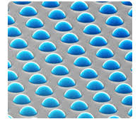
Flavors of Infinium Chemistry
Unmethylated Sample
Methylated Sample
In-Band
In-Band
A
G
In-Band
T
G
Out-Of-Band
Out-Of-Band
G
T
In-Band
Distributions are in log scale and the out-of-bound channels need to be separated [when I have time]

Slide 29
Customer Rational VA MVP Fingerprinting Requirements

Slide 30
Customre Rational
VA MVP Fingerprinting Requirements
Why such a need for Fingerprinting from a methylation array???
EPICv1 Sample Volume > 100k
EPICv2 Sample Volume >> 100k
Samples Analyzed on Different Data-Types/Platforms
Genotyping
Gene Expression
Methylation
Proteomics
…
Multiple Venders for all the above
Basically: Data Driven Sample Tracking is Required!

Slide 31
Current Implementation Sesame Circa 2019

Slide 32
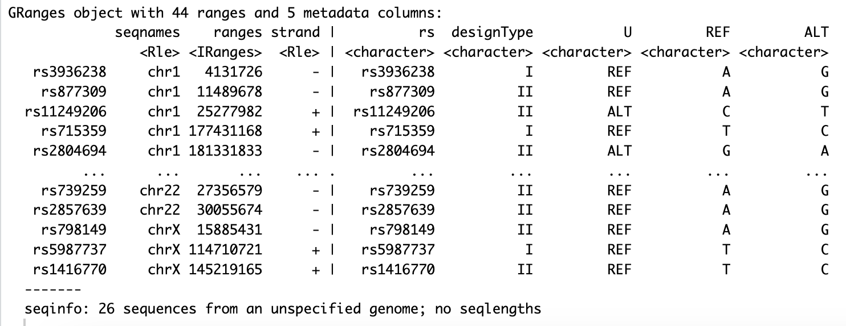
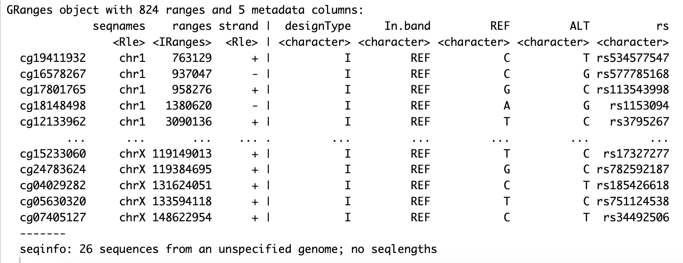
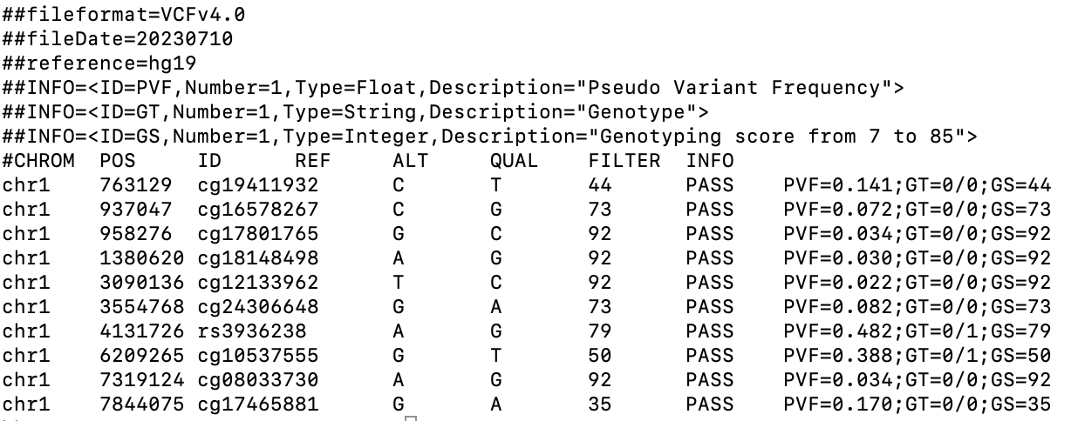
Current Implementation
Sesame Circa 2019
Previous Data Source:
https://zwdzwd.s3.amazonaws.com/InfiniumAnnotation/20200704/EPIC/EPIC.hg19.snp_overlap_b151.rds
Direct SNV Detection (annoS) Inferred SNV Detection (annoI)
Previous Results: Genotype Style VCF File

Slide 33
Missing Implementation
Sesame Circa EPICv2
Previous Data Source:
https://zwdzwd.s3.amazonaws.com/InfiniumAnnotation/20200704/EPIC/EPIC.hg19.snp_overlap_b151.rds
Direct SNV Detection (annoS) Inferred SNV Detection (annoI)
Need to rebuild annoS and annoI for EPICv2 probes…

Slide 34
Current Implementation
Sesame EPICv2 Workflow
Intersect EPICv2 against dbSNP151 using tabix:
Range = [Coordinate -1, Coordinate + 2]
[-1 +2]
GTGCGGGCGUTGUTGGAGG[CG]GGGGCGUTGUUUAACGUA-
Remove Variants that do not match Probe_Type (i.e. Direct should be at the interrogation site, Inferred should be at the proper Next Base)
Remove Allele’s with non-reported allele frequencies.
Remove Allele’s that are not functional under bisulfite conversion rules.
…
Build annoS and annoI Genomic Ranges and add to docker image.

Slide 35
Current Implementation Caveats Trials and tribulations of three-year-old code [yes; double entendre ]

Slide 36
Current Implementation Caveats
Trials and tribulations of three-year-old code [yes; double entendre ]
Long List of minuet trials and tribulations to meet three-year-old Sesame code requirements: TO BE FILLED IN
Probe_ID: EPICv1 (no-suffix) vs. EPICv2 (with-suffix) naming issue.
Probe_ID: Mapping to multiple alleles.
…
FILL IN THE REST
All of these issues should be properly handled in future software…

Slide 37
Future Development A proper and integrated solution

Slide 38
Future Development
A proper and integrated solution
Use existing Genotyping tools to map a manifest against a dbSNP version.
Caveats:
Extend Bisulfite Conversion rules to remove non-detectable variants [add example]
Extend Converted/Opposite rules to remove non-detectable variants [add example]
Allow for both Direct and Inferred annotation
Allow for multi-allelic variants under Bisulfite Conversion rules
Allow for Indels that bump right against variant under BS rules
Do all the above, but for Dream (TAPS) rules for future products.
Next Steps: Investigate current Genotyoping tools.
What additional manifest fields are needed for methylation?

Slide 39
Docker Installation/Usage Appendix

Slide 40
Outline:
May 16th, 2023
Advantages/Disadvantages
Docker
Pull Command
Example Execution
Parameters (in shell file format)
Run Command

Slide 41
Advantages/Disadvantages:
May 16th, 2023
Advantages:
Built in EPIC v1/v2 manifests
No need for BOX/downloads
Static and Optional Execution Scripts
run_swifthoof.sh
run_swifthoof.options.sh
Inference Calling:
Supported
GCT Score
Sex Call
Sex Karyotype
AgeSkinBlood
Not Currently Supported
Ethnicity

Slide 42
Docker:
Pull Command
# No EPICv2 Fingerprinting:
docker pull bbarnesimdocker/im_workhorse:Infinium_Methylation_Workhorse_Centos.v.1.11.15.1.p.0.4
# EPICv2 Finger Printing Enabled:
docker pull bbarnesimdocker/im_workhorse:Infinium_Methylation_Workhorse_Centos.v.1.11.15.1.p.0.6.2

Slide 43
Example Execution:
Parameters
IMG="bbarnesimdocker/im_workhorse:Infinium_Methylation_Workhorse_Centos.v.1.11.15.1.p.0.4"
DAT="PATH_TO_YOUR_IDAT_DIRECTORY"
OUT="PATH_TO_YOUR_OUTPUT_DIRECTORY"
LOG="PATH_TO_YOUR_LOG_OUTPUT_FILE"
# These options are only available if you use SCRIPT="run_swifthoof.options.sh”
OPT="--fresh --minPerc=96,98 --minPval=0.05,0.02 ”
# Set to whatever level you want
VER="--verbose=3"
# Run Standard Version::
# SCRIPT="run_swifthoof.sh"
#
# Run to Allow Options::
SCRIPT="run_swifthoof.options.sh"

Slide 44
Example Execution:
Run Command
docker run -i --rm \
-v ${DAT}:/work \
-v ${DAT}:/input \
-v ${OUT}:/output \
-w /work \
${IMG} ${SCRIPT} ${OPT} \
--auto_detect \
${VER} \
&> ${LOG}

Slide 45
Example Data:
idats
Steven has included the EPICv1 vs. EPICv2 datasets that you can access and verify the Docker Outputs. Including sample descriptions in Readme file.
BOX Location: https://illumina.app.box.com/folder/199780647062

Slide 46
Appendix

Slide 47
Beyond simple chemistry…
P16 sequence
GTGCGGGCGCTGCTGGAGG[CG]GGGGCGCTGCCCAACGCA-> original TOP
<-CACGCCCGCGACGACCTCC[GC]CCCCGCGACGGGTTGCGT original BOT
Bisulfite conversion + amplification
SBE (II)
SBE (II)
ASPE (I)
ASPE (I)
GTGCGGGCGUTGUTGGAGG[CH]GGGGCGUTGUUUAACGUA-> TCM GTGUGGGUGUTGUTGGAGG[UH]GGGGUGUTGUUUAAUGUA-> TCU
<-CACGCCCGCAACAACCTCC[HC]CCCCGCAACAAATTGCAT TOM <-CACACCCACAACAACCTCC[HC]CCCCACAACAAATTACAT TOU
ATACGAACGCTACTAAAAA[CH]AAAACGCTACCCAACGCA-> BOM ATACAAACACTACTAAAAA[CH]AAAACACTACCCAACACA-> BOU
<-UAUGCUUGCGAUGAUUTUU[HC]UUUUGCGAUGGGTTGCGT BCM <-UAUGUUUGUGAUGAUUTUU[HU]UUUUGUGAUGGGTTGUGT BCU
GTGCGGGCGUTGUTGGAGG[CG]GGGGCGUTGUUUAACGUA-> TCM GTGUGGGUGUTGUTGGAGG[UG]GGGGUGUTGUUUAAUGUA-> TCU
<-CACGCCCGCAACAACCTCC[GC]CCCCGCAACAAATTGCAT TOM <-CACACCCACAACAACCTCC[AC]CCCCACAACAAATTACAT TOU
ATACGAACGCTACTAAAAA[CG]AAAACGCTACCCAACGCA-> BOM ATACAAACACTACTAAAAA[CA]AAAACACTACCCAACACA-> BOU
<-UAUGCUUGCGAUGAUUTUU[GC]UUUUGCGAUGGGTTGCGT BCM <-UAUGUUUGUGAUGAUUTUU[GU]UUUUGUGAUGGGTTGUGT BCU
ASPE (I)
ASPE (I)
Converted Strand
SBE (II)
SBE (II)
Opposite Strand
SBE (II)
SBE (II)
ASPE (I)
ASPE (I)
ASPE (I)
ASPE (I)
SBE (II)
SBE (II)
TCM – Top Converted Methylated
TOM – Top Opposite Methylated
BOM – Bottom Opposite Methylated
BCM – Bottom Converted Methylated
TCU – Top Converted Unmethylated
TOU – Top Opposite Unmethylated
BOU – Bottom Opposite Unmethylated
BCU – Bottom Converted Unmethylated
All CG’s are currently designed to the Converted Strand
All CH’s are designed to the Opposite Strand
We can design many SNPs as well (not shown)

Slide 48
Workhorse: Analysis Pipeline: Docker image to make life easy

Slide 49
Analysis Software:
Genome Studio: This was the original workflow developed for the 27k, 450k and EPIC arrays by Illumina. The workflow is very outdated and has not been updated since 2009.
Minfi: This software has largely been the workhorse for many Infinium Methylation projects. It is commonly used as the underlying statistical framework for many other popular analysis platforms.
https://bioconductor.org/packages/release/bioc/html/minfi.html
ChAMP: https://bioconductor.org/packages/release/bioc/html/ChAMP.html
RnBeads: https://bioconductor.org/packages/release/bioc/html/RnBeads.html
wateRmelon: https://bioconductor.org/packages/release/bioc/html/wateRmelon.html
Bigmelon: http://bioconductor.org/packages/release/bioc/html/bigmelon.html
SeSAMe: This is the most recent (to our knowledge) and cutting-edge analysis package. It serves both as a statistical framework and provides many additional functions.
https://bioconductor.org/packages/release/bioc/html/sesame.html
MethylSuite: This is a growing open source pythonized version of Sesame.
https://pypi.org/project/methylsuite/

Slide 50

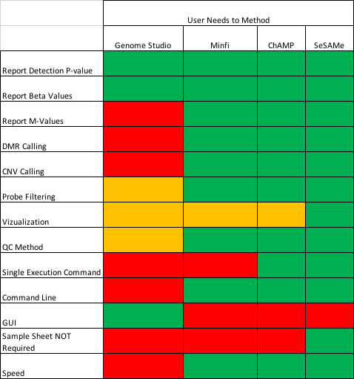
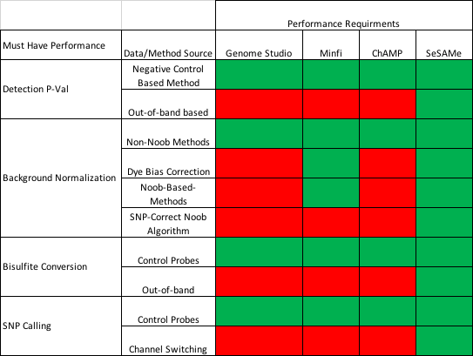
Why So Many Software Packages???
Required Template slide – update with project information

Slide 51
Analysis Workflow Methods:
General Methods:
Detection P-value: Measure of detection for each locus
Dye Bias Correction: Normalizing the signal between two-color channels
Background Correction: Removing the effect of background
Interpretation Correction: Identifying the correct color channel based on data
Functional Methods:
Age Predictions: Horvath Age Predictions
Ethnicity Prediction: Identifying the correct color channel based on data
Cell Deconvolution: Approximate cell flow cytometry
Many more…

Slide 52
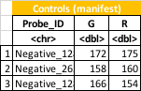
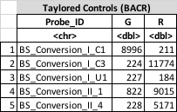
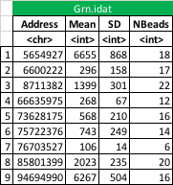
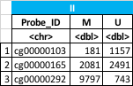
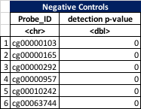
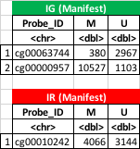
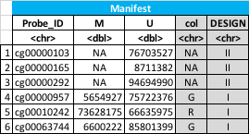
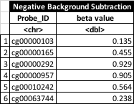
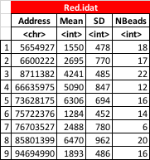
Genome Studio
Methylation Module (2011)
Negative Detection
P-value
Negative Background Subtraction
Dye Bias Correction
State of the art circa 2009
* Has not been updated sense then…

Slide 53
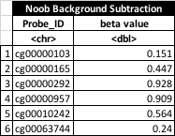
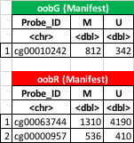
Minfi Workflow
Generalized
Negative Detection
P-value
Dye Bias
Correction
Noob Background Subtraction
Commonly Used
Statistical Framework

Slide 54
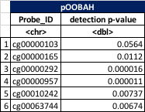
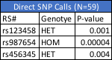
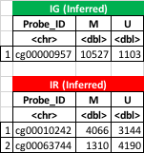
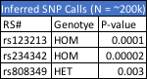
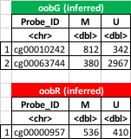
Open Sesame!!!
Generalized
Negative Detection
P-value
Dye Bias
Correction
Noob Background Subtraction
pOOBAH Detection
P-value
Most Recent, Robust,
State-of-the-Art Framework

Slide 55
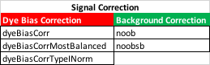
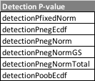
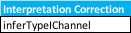
Analysis Workflow Steps Available in Sesame:
Workhorse wraps SeSAMe provided workflows.
Note: Sesame does not support Negative control-based background subtraction.
Core Sesame Methods:

Slide 56
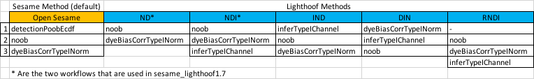
Supported Order of Operations:
Due to the flexibility of SeSAMe you can choose the order of operations.
Currently Lighthoof supports the following workflows:
For COVIC Project we current only look at two workflows:
I: InferredTypeIChannel()
Basically, the raw data with channel swapping
IND: InferredTypeIChannel() -> noob() -> dyeBiasCorrTypeINorm()
Basically, the standard Sesame workflow with channel swapping

Slide 57
Workhorse::Lighthoof Pipeline Output: OUT OF DATE
For each Sample, the following files are produced:
AutoSampleSheet.csv.gz: A Sample Sheet similar to sample sheets required by Genome Studio as input. This includes summary statistics as well as a ’ Requeue’ flag indicating the sample did not pass and should be requeued or further investigated.
call.csv.gz: This contains both p-values and beta values for specified workflows.
sigs.csv.gz: This contains the raw and normalized signals for specified workflows.
SignalSummary.csv.gz: This provides detailed summary signal statistics for specified workflows.
MISSING SNP.VCF FILE

Slide 58
Workhorse::Lighthoof Auto Sample Sheet
AutoSampleSheet.csv.gz: A Sample Sheet similar to sample sheets required by Genome Studio as input. This includes summary statistics as well as a ’ Requeue’ flag indicating the sample did not pass and should be requeued or further investigated.

Slide 59
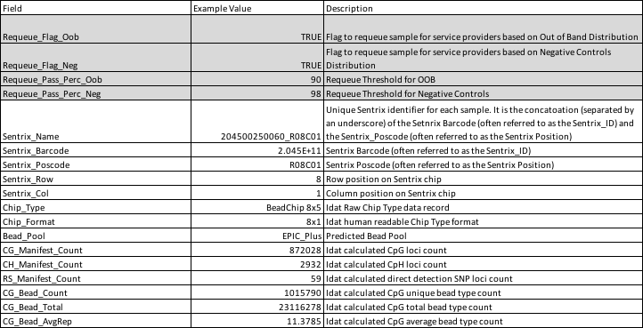
Workhorse::Lighthoof Auto Sample Sheet

Slide 60
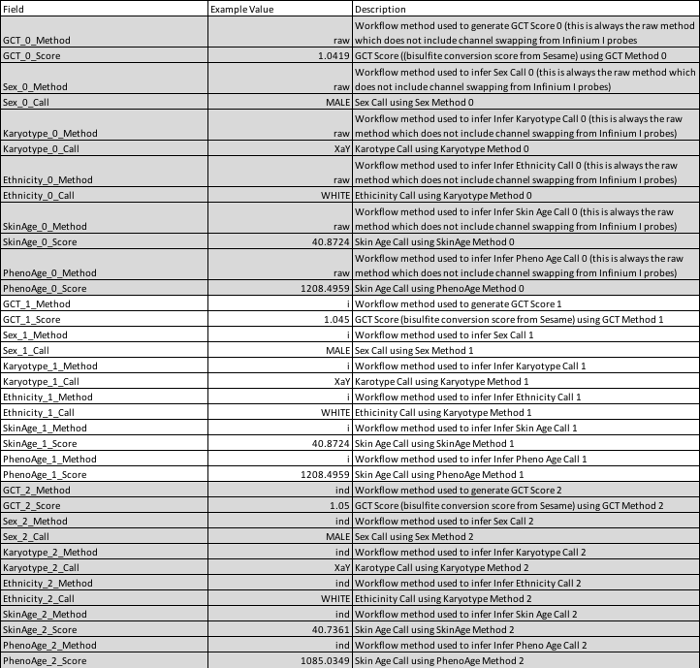
Workhorse::Lighthoof Auto Sample Sheet

Slide 61
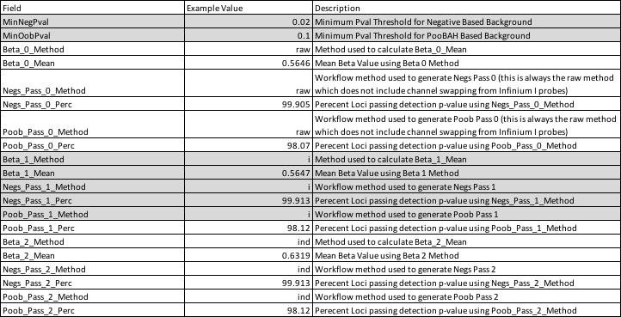
Workhorse::Lighthoof Auto Sample Sheet

Slide 62
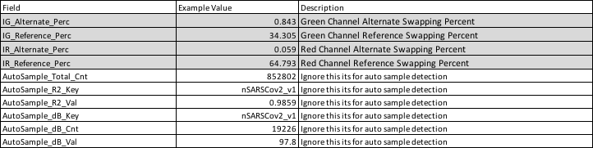
Workhorse::Lighthoof Auto Sample Sheet

Slide 63
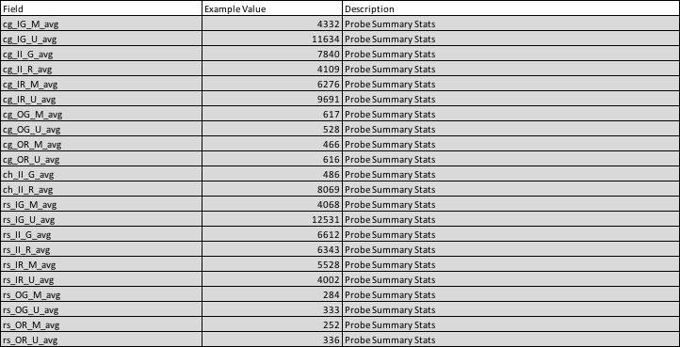
Workhorse::Lighthoof Auto Sample Sheet

Slide 64
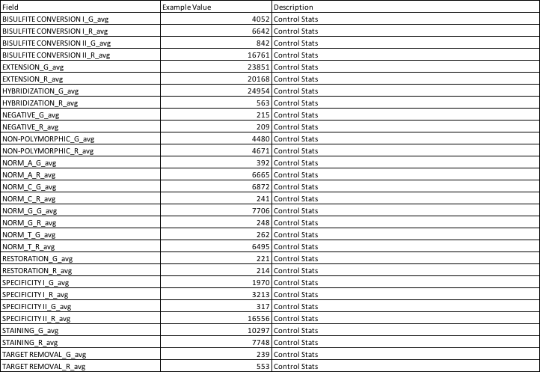
Workhorse::Lighthoof Auto Sample Sheet

Slide 65
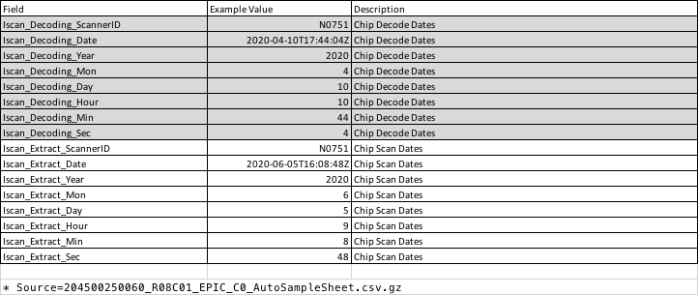
Workhorse::Lighthoof Auto Sample Sheet

Slide 66
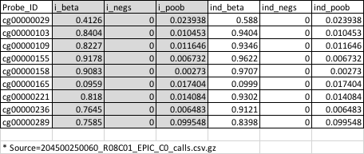
Workhorse::Lighthoof Calls File
call.csv.gz: This contains both p-values and beta values for specified workflows.

